Slide 1
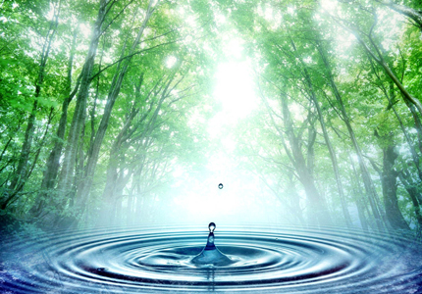
Unit 3 Water Resources

Slide 2
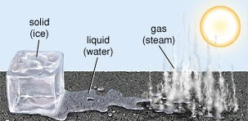
Water
80 % of land surface is covered by water.
Trees 60 % made up of water.
Animals are made up of 50 – 60% of water.
Forms of Water
Solid.
Liquid.
Gas.

Slide 3
Hydrological Cycle
Evaporation
Transpiration
and
Respiration
Condensation
and
Precipitation

Slide 4
Distribution of water resources

Slide 5
Types of Fresh Water Resources
Fresh Water
Surface Water
Underground Water
Standing Water
Flowing Water
Lakes
Reservoirs
Estuaries
Streams
Rivers

Slide 6
Underground Water
Types
Aquifer
Unconfined aquifers.
Confined aquifers.

Slide 7
Uses of Water
Consumptive Value
Domestic.
Industry.
Irrigation.
Non Consumptive Value
Hydropower plant

Slide 8
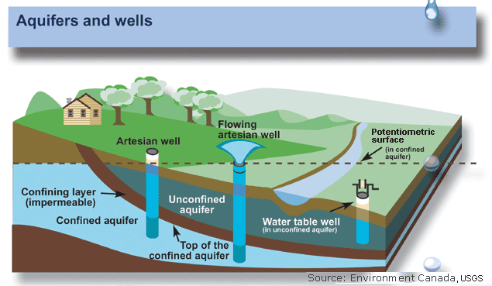
Uses of Water

Slide 9
Use of Water
Drinking, Bathing, Cooking.
Commercial use hotel, theatres, offices.
60 – 70 % is a free water irrigation.
20-30% of fresh water is used for refineries, iron and steel, paper and pulp industries.
Sculpts the earth surface and moderating climate, diluting pollution.

Slide 10
Over Utilization of water
Effects of over utilization
Decrease of Ground Water
Reasons
Inadequate rainfall.
Building construction activities sealing permeable zone.
Ground subsidence
Problems
Structural Damage of building
Fracture in pipes.

Slide 11
Over Utilization of water
Effects of over utilization
Lowering of water table.
Intrusion of salt water.
Earth Quake and landslides.
Drying up of wells.
Pollution of water.

Slide 12
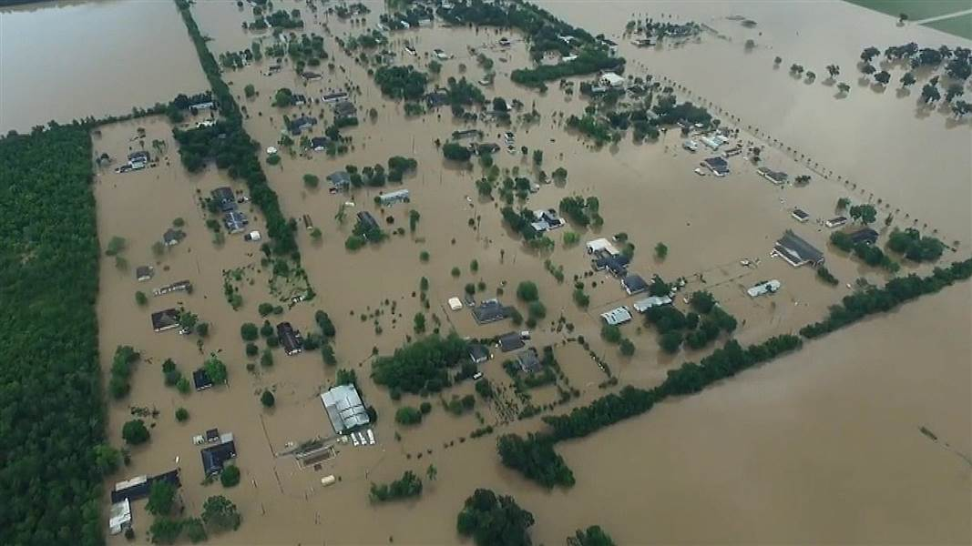
Floods
Flood is an overflow of water whenever the magnitude of flow of water exceeds the carrying capacity of the channel within its banks.

Slide 13
Causes of Floods
Heavy rainfall, melting of snow, sudden release of water from dams.
Long term of Raining.
Reduction of carrying capacity of channels.
Deforestation, overgrazing, mining.

Slide 14
Effects of floods
Submerges of land.
Cultivable lands of affected.
Extinction of civilization.

Slide 15
Flood Management
Construction of Dams.
Channel Managements.
Encroachment of flood ways must be banned.
Flood Warnings.
Aforestration Activities.

Slide 16
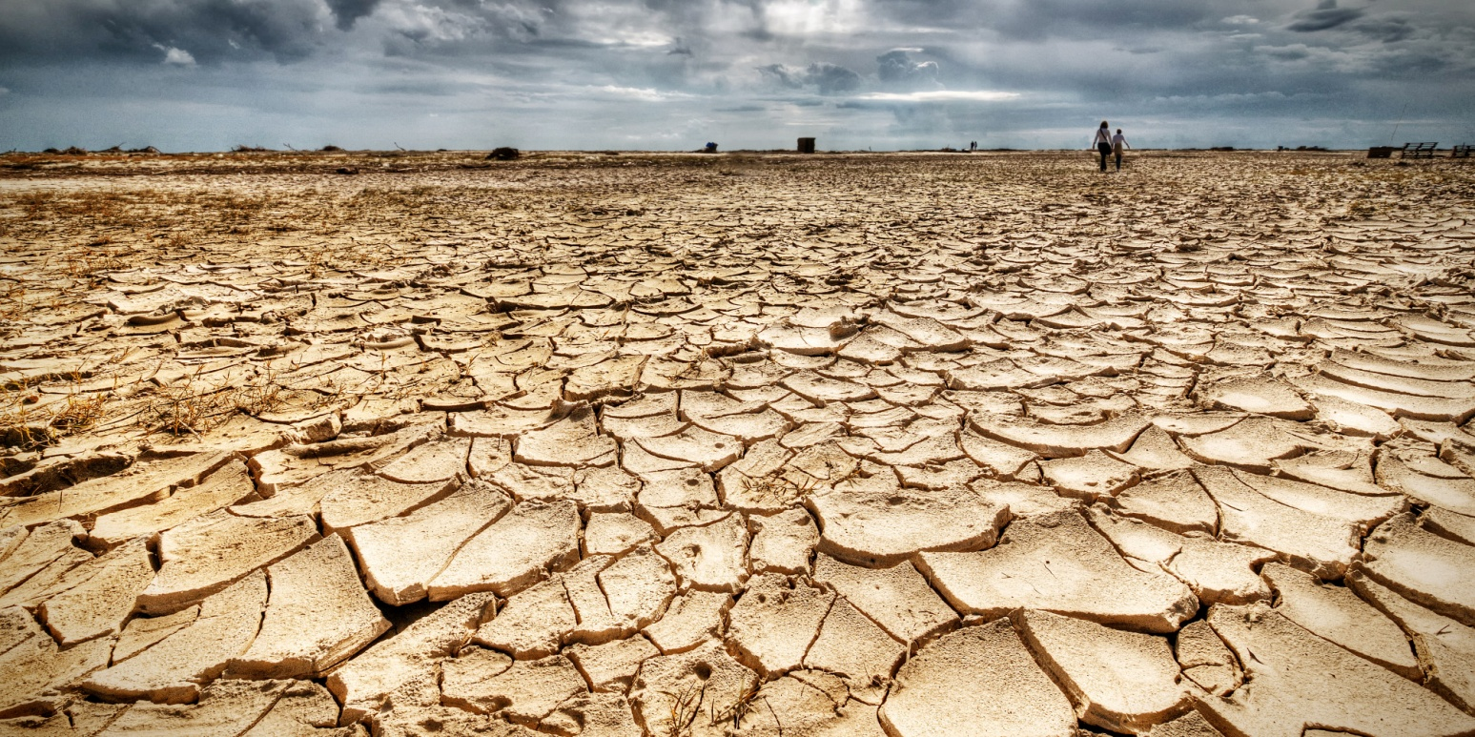
Drought
It is a scarcity of water, which occurs due to inadequate rainfall, late arrival of rains and excessive withdrawal of ground water.

Slide 17
Types of Drought
Metrological Drought
Hydrological Drought
Agricultural Drought
Socio-Economic Drought

Slide 18
Causes of drought
Annual rainfall is below normal rainfall.
Population growth and poor use of land.
Intensive cropping pattern and over exploitation of ground water for high productivity.
Eg Maharastra
Deforestation leads to desertification.

Slide 19
Effects of Drought
Hunger, Malnutrition, and scarcity of drinking water, change in quality of water.
Crop failures leading to acute shortage of food.
It is a first stage of desertification.
It accelerates degradation of natural resource.
Causes large migration of people.

Slide 20
Drought Management
Rainwater harvesting.
Construction of reservoirs increases the ground water level in drought area.
Morden irrigation ( Drip irrigation )
Afforestation activities.
Mixed cropping.

Slide 21
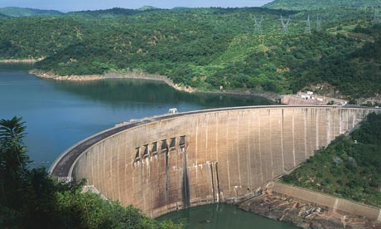
Dams

Slide 22
Benefits of Dams
We control the flood and store flood water.
Diverting water to channel.
Drinking and agricultural purpose.
Used to generate electricity.
Become a spot for fishery.

Slide 23
Upstream Problems
Displacement of tribal people.
Loss of forest, flora and fauna.
Reservoir induced seismicity (Earth Quake)
Breeding of Diseases causing vectors.
Stagnations and water logging retards plants growth.

Slide 24
Down stream Problems
Water logging and salinity due to over irrigation.
Reduced water flow and slit deposit in rivers.
Saltwater intrusion at rivers mouth.
Sediments are deposited in dams not in river beds.
Sudden collapse of dam is always a dangerous .

